Slide 1
Image Captioning
Using Deep learning
For Visually Impaired
Team members:
Rohit Kumar - 01FE18BCS178
Aditya Mutagi - 01FE18BCS019
Shashidhar M - 01FE18BCS199
Akash D H - 01FE18BCS021
Raghavendra B - 01FE18BSC163
Senior Design Project Team - D 24
Guide: Dr. S.G. Totad

Slide 2
Introduction

Slide 3
Problem statement
Our aim to build an application to be able to interpret images and give a comprehensible text about the given image using deep learning frameworks such as CNN and LSTM deep neural networks.
The purpose of this project is to provide an application for visually impaired people to be able to understand and interpret an image to some satisfactory degree and improve their experience and involvement on the internet.

Slide 4
Motivation
Interpreting images is a daunting task for visually impaired. Their inability to comprehend images hinders their overall experience of internet browsing. Many successful models have been built for text-to-speech, but not for describing images. Normal screen readers that are available for visually impaired people are implemented using the text-to-speech APIs available.
So, a person who is relying on these applications might lose the context since images cannot be read out loud. There is a need to fill in that contextual gap that exists between images and text-to-speech screen readers.

Slide 5
Literature Survey

Slide 6
1. Base Paper – ‘Show, Attend, and Tell: Neural Image Caption Generation with Visual Attention’ by Kelvin Xu and his team
They introduced an attention-based model that automatically learns to describe the content of images.
To train the model, standard backpropagation techniques are used. they validate the use of attention with state-of-the-art performance on three benchmark datasets: Flickr 8k, Flickr30k, and MS COCO.
The model brings together convolutional neural networks, recurrent neural networks and works in modeling attention mechanisms.

Slide 7
2. ‘Image Captioning for Ambient Awareness on a Sidewalk’ by Faruk Ahmed, Md Sultan Mahmud, Rakib Al-Fahad, Shahinur Alam, and Mohammed Yeasin.
The design and implementation of a system embedded in an RPi3 is part of the experiment.
They have considered two types of inputs: voice command and button press. A user can choose to have spoken feedback, haptic feedback, or a certain tone for obstacles

Slide 8
3. ‘Image Captioning’ by Vikram Mullachery, Vishal Motwani.
They used three different datasets to train and evaluate their data models. They are MSCOCO, Flickr30k and Flickr 8k.
They used the baseline model designed by A.Karpathy and improve upon that model by increasing the RNN layers and using ResNet in lieu of VGGNet.
This model uses 16 layers VGGnet for embedding image features and single layer RNN constituted of LSTM.
They have attempted three different types of improvisation over the baseline model.
Performed further training of the model on Flickr30k and Flickr 8k and initialized weights of the model with the baseline model.
Increasing the number of hidden layers in the RNN over the baseline model
Used ResNet in place of VGGNet

Slide 9
4. ‘Image Captioning using Deep Learning: A Systematic Literature Review’ by Murk Chohan, Adil Khan, Muhammad Saleem Mahar, Saif Hassan, Abdul Ghafoor, Mehmood Khan
In this study they have found that CNN is used to understand image contents and find out
objects in an image while RNN or LSTM is used for language generation.
It was also found that LSTM with CNN has outperformed RNN with CNN.
The purpose of this Systematic Literature Review is to study
all newest Articles from 2017 to 2019 to find different methods to achieve auto image captioning in different domains.
what different datasets are used to achieve the task.
In which different practical domains this task is used.
which technique Outperforms others and finally attains to describe the technicalities behind different networks, methods and evaluation matrices.

Slide 10
Existing Solution Methods
Microsoft has built a model via the Azure Cognitive Services Computer Vision offering, which is part of Azure AI, enabling developers to use this capability to improve accessibility in their own services.
Google has released its “Show and Tell” image captioning algorithm to developers, who can train it to recognize objects in photos.

Slide 11
Problem Formulation
Data Understanding: Load the data and understand the representation.
Data preprocessing: In this step, we will process both images & captions to the desired format.
Train/Test Split: Combine both images & captions to create the train & test dataset.

Slide 12
Problem Formulation
Model-Building: Objects are detected from the image with the help of CNN then by y using LSTM, sentences are generated. Each predicted word is employed to get subsequent words. Using these words, appropriate sentence is formed with the help of Optimal beam search. Here, SoftMax function will be used for prediction of word.
Model Evaluation: Evaluate the models using BLEU score.

Slide 13
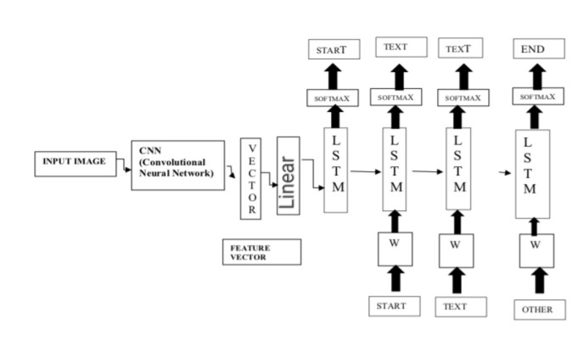
Problem Analysis

Slide 14
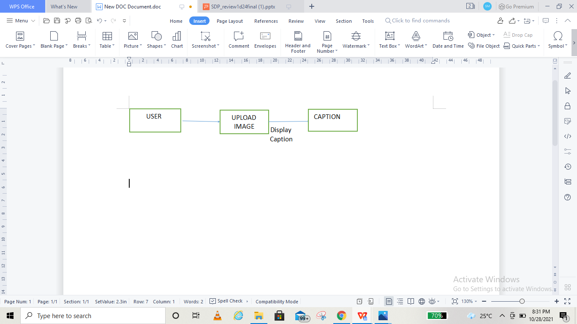
Problem Analysis DFD Diagram Level 0

Slide 15
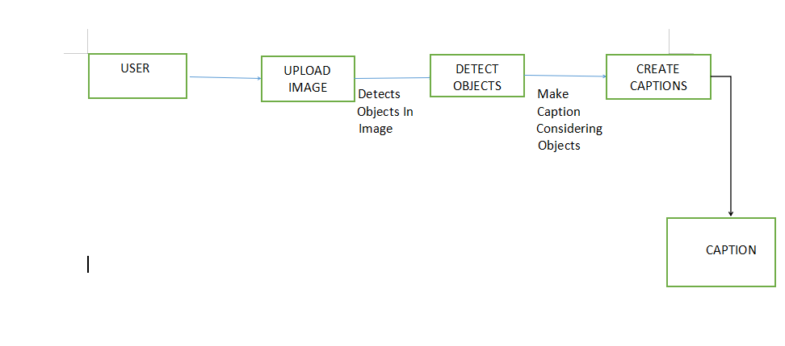
DFD Diagram Level 1

Slide 16
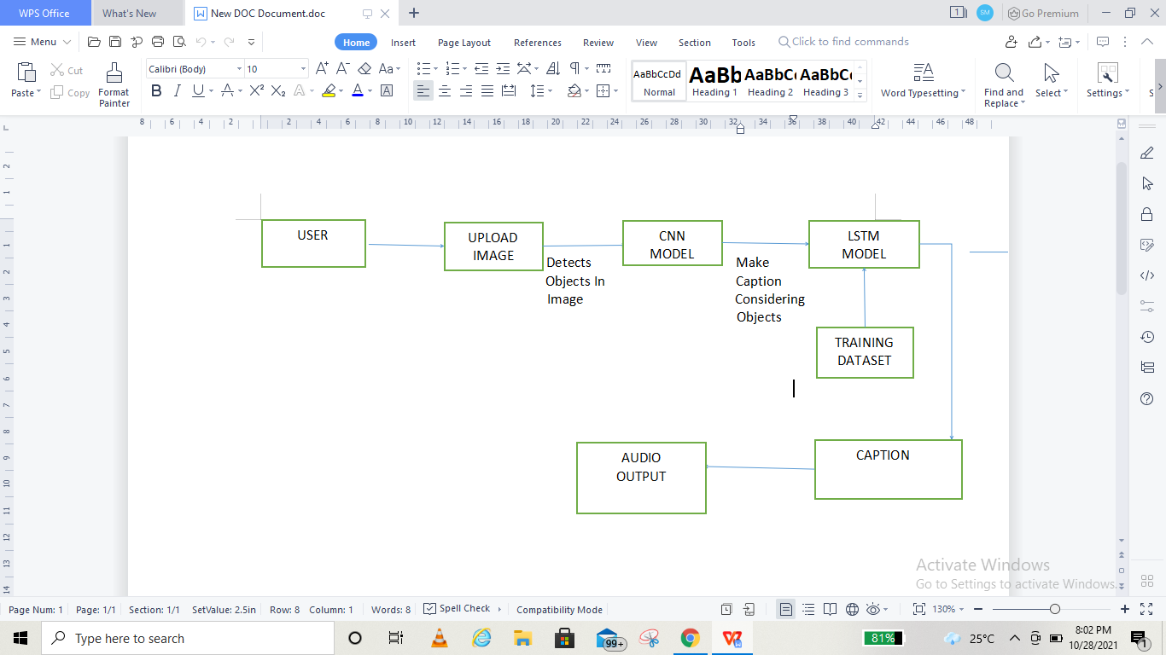
DFD Diagram Level 1

Slide 17
Objectives
Recognize the objects in image using CNN and prepare a feature vector.
Convert the caption sentence to speech for better reach.
Generate a brief sentence using the feature vector.
Provide a user interface for ease of access.

Slide 18
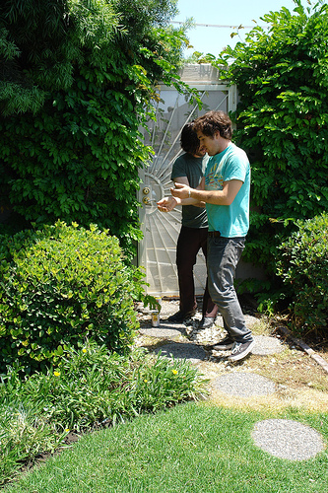
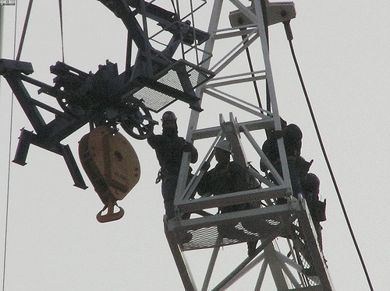
Dataset
Flicker 30k dataset will be used for training the model has 31000 images with 5 captions for each image in a .csv format.

Slide 19
References

Slide 20
‘Image Captioning for Ambient Awareness on a Sidewalk’ by Faruk Ahmed, Md Sultan Mahmud, Rakib Al-Fahad, Shahinur Alam, and Mohammed Yeasin.
‘Image Captioning’ by Vikram Mullachery, Vishal Motwani.
‘Show, Attend and Tell: Neural Image Caption Generation with Visual Attention’ by Kelvin Xu and his team
‘Image Captioning using Deep Learning: A Systematic Literature Review’ by Murk Chohan, Adil Khan, Muhammad Saleem Mahar, Saif Hassan, Abdul Ghafoor, Mehmood Khan
‘Image Captioning using Deep Neural Architectures’ by Parth Shah, Vishvajit Bakrola, Supriya Pati

Slide 21
Thank You

